Slide 1

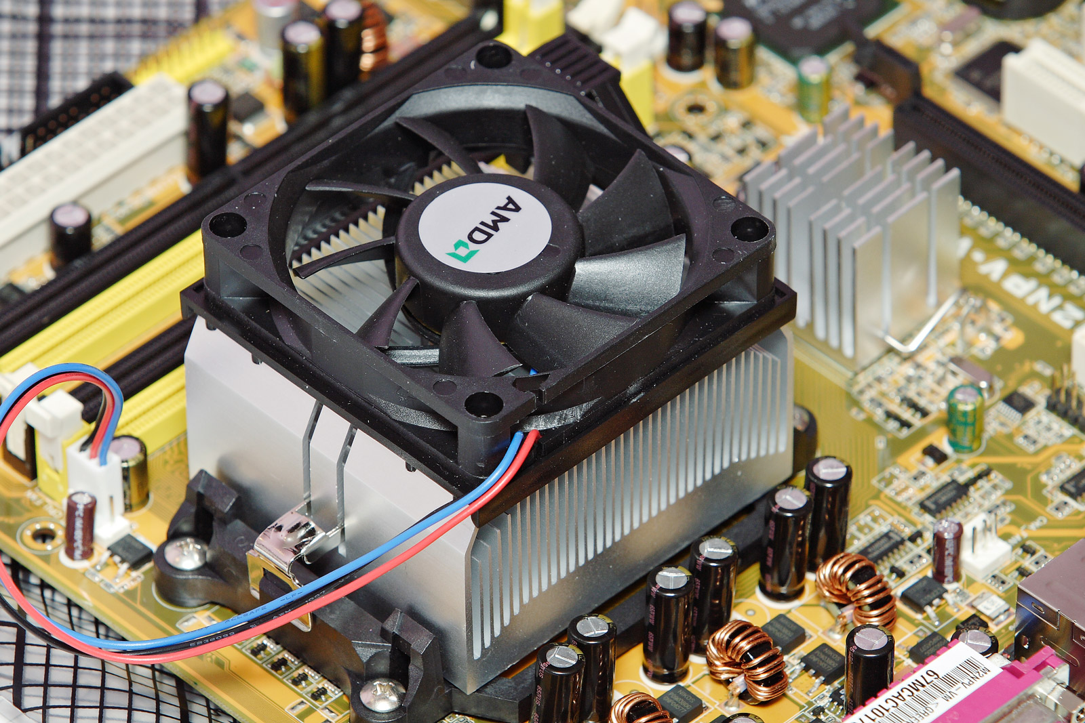

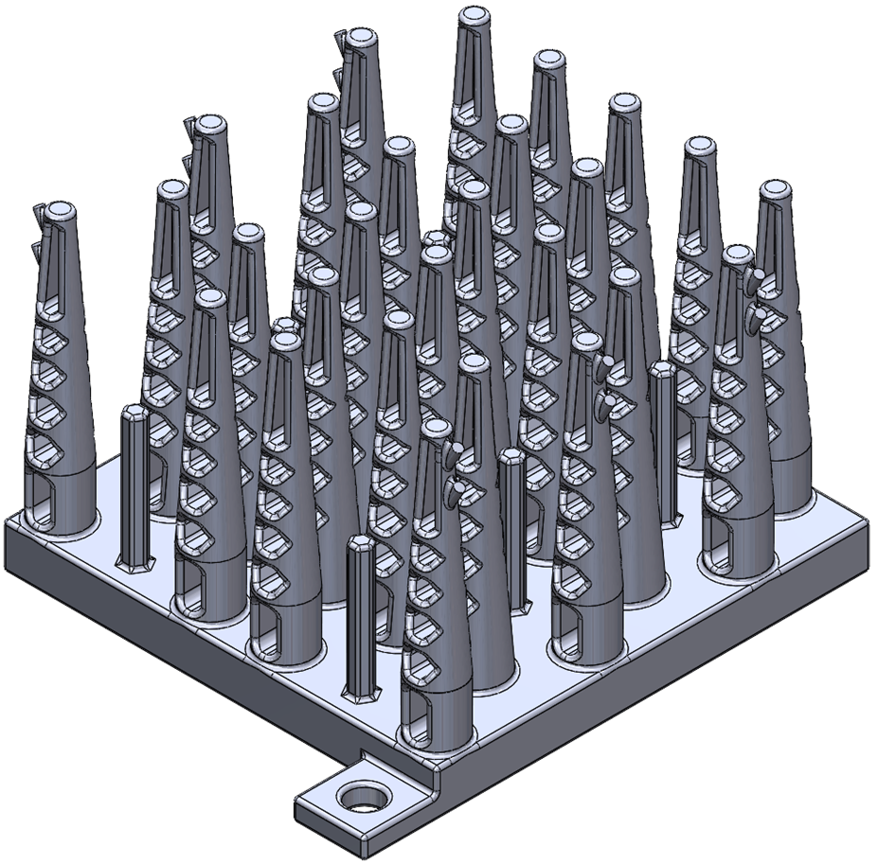
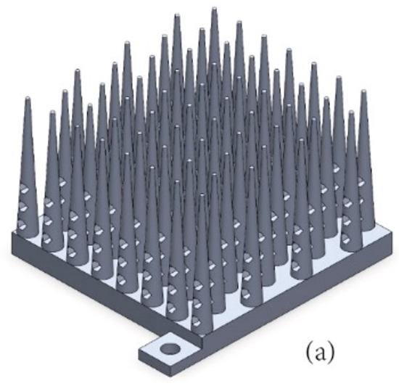
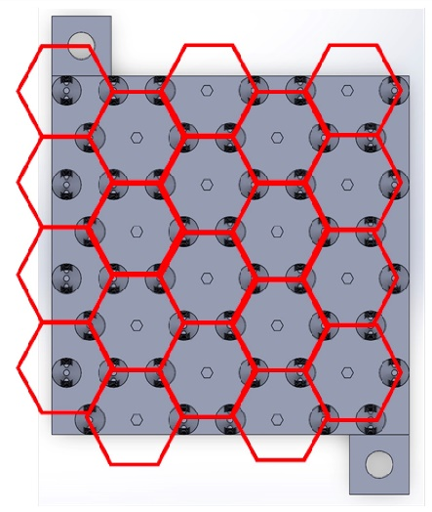
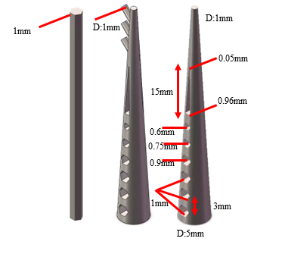
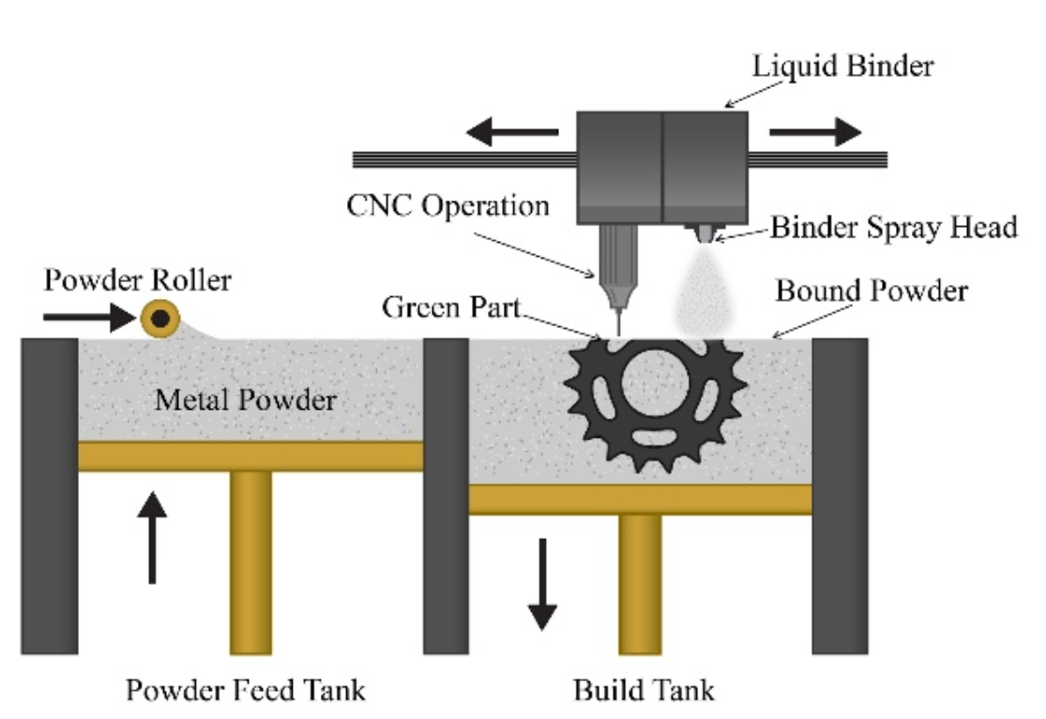
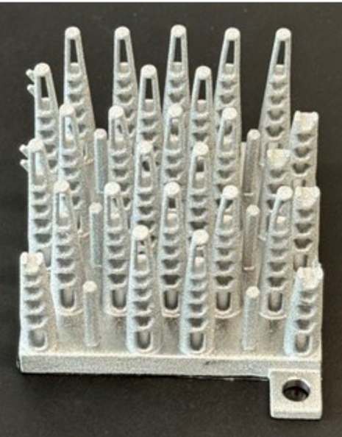
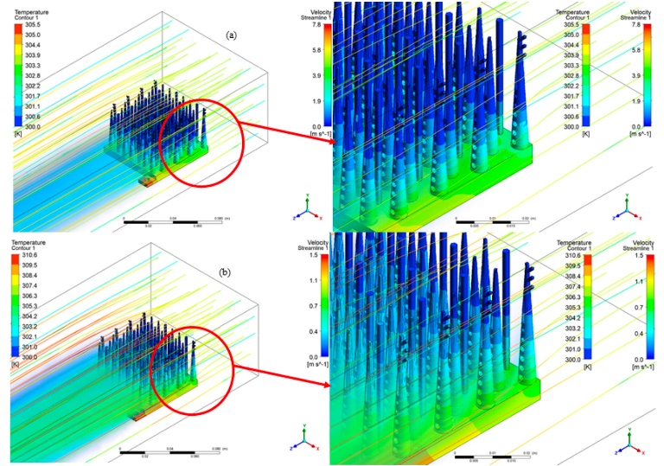
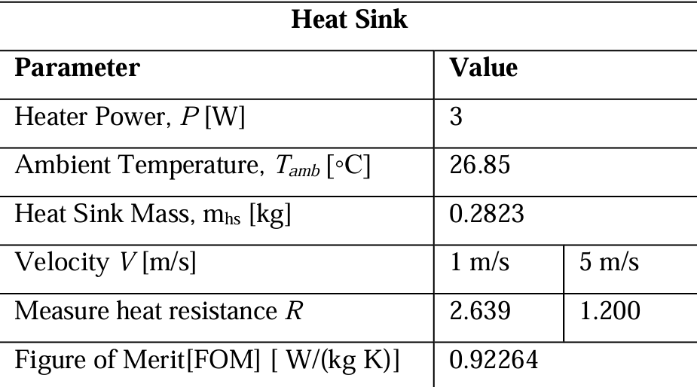
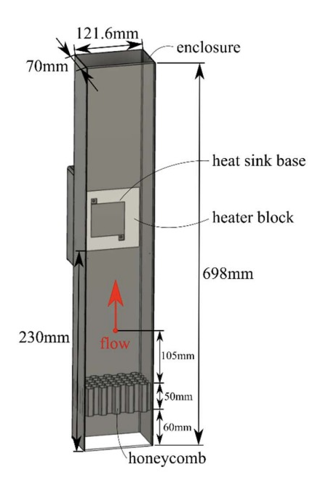
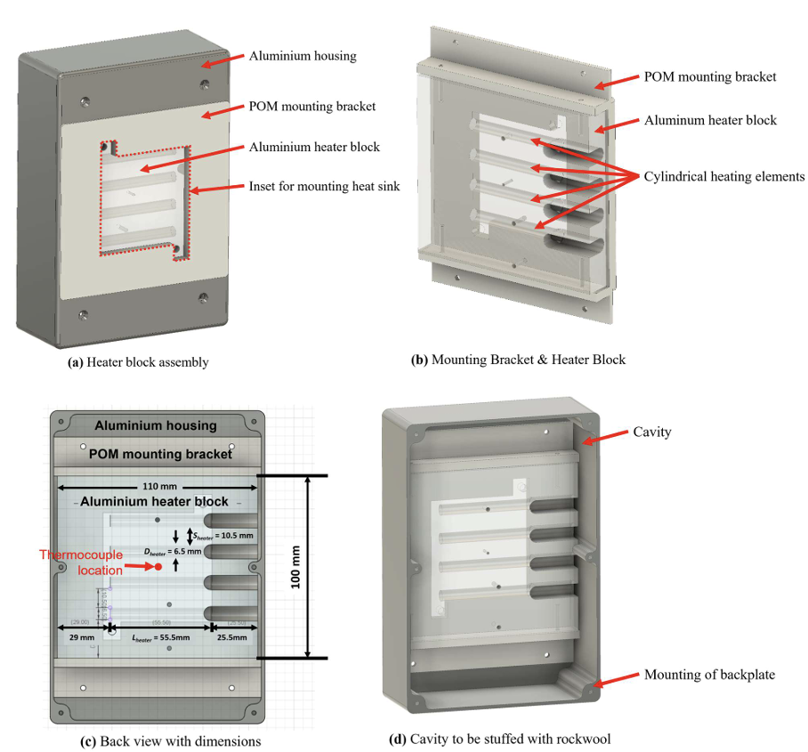
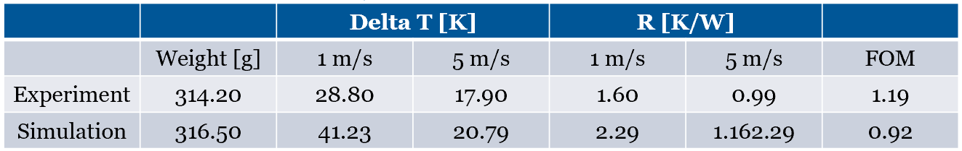
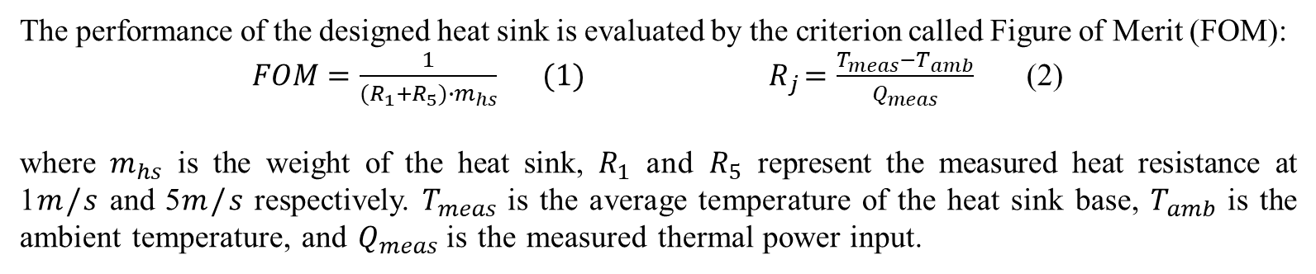
Bionic Design and Additive Manufacturing of High-Performance Heat Sink
Yang Zhang, Junyuan Jiang, Yiwei Wang, Luying Xia
Supervisors: Dr. Yi Nie and Dr. Shanshan Long Aerospace Engineering, Department of Mechanical, Materials and Manufacturing
Background and Motivation
Heat sink: heat exchanger that dissipates the heat generated by an electronic or a mechanical device
Additive Manufacturing (AM): an industrial process that deposits materials layer by layer to create geometric 3D objects.
Motivation: To generate an innovative heat sink design that maximizes the benefits of additive manufacturing, particularly in terms of intricate geometries and robust materials.
Honeycomb and dendritic structure
AM of intricate geometries
Structural Design
Additive Manufacturing
Bionic design:
Angle larger than 60 degrees to horizontal direction
Aspect ratio smaller
than 6.7
Excellent heat dispassion ability by enhanced convection and contact area with air
Rebuild the model to ensure all the feature sizes are greater than 1.0 mm.
Modification of the design for binder jetting
Honeycomb arrangement of conical pins
Change to ellipse
chamfer
Conical pins structure
Tree branches structure
Binder jetting metal additive manufacturing
Printed heat sink
Computational simulation
Experimental validation
Predicted FOM of the design heat sink
Contour of temperature distribution on the surface of the heat sink
The performance of the designed heat sink is evaluated by the criterion called Figure of Merit (FOM):
$FOM=\frac{1}{(R_{1}+R_{5})∙m_{hs}}{ (1) R}_{j}=\frac{T_{meas}−T_{amb}}{Q_{meas}}$ (2)
where $m_{hs}$ is the weight of the heat sink, $R_{1}$ and $R_{5}$ represent the measured heat resistance at 1$m/s$and 5$m/s$respectively. $T_{meas}$ is the average temperature of the heat sink base, $T_{amb}$ is the ambient temperature, and $Q_{meas}$ is the measured thermal power input.
Experiment set-up
Results & Analysis
Conclusions
1. The breakage of the pins impact on FOM 1.1% error
2. Chamfer of pins impact on FOM 9.2% error
3. Surface roughness of the printed model h coefficient
4. Heat transfer: Incomplete to heat sink.
A bionic heat sink: conical pins, honeycomb holes, raised branches, a honeycomb pattern, and enhanced aesthetic appeal.
The predicted figure of merit (FOM) was calculated to be 0.92264 W /(kg·K).
The aspect-ratio, 60-degree rule and minimal feature size were strictly followed to make the designed heat sink suitable for fabrication by binder jet additive manufacturing.
The Experimental FOM was measured to be 1.19 W /(kg·K), together with convincing error analysis.
Experimental and Simulated FOM of the design heat sink

